Slide 1
Git & GitHub
DATA-LA 485
https://happygitwithr.com/

Slide 2


Git
Git is a free and open source version control system
https://git-scm.com/
It is a system that records changes to a file or set of files over time so that you can recall specific versions later.
Git

Slide 3

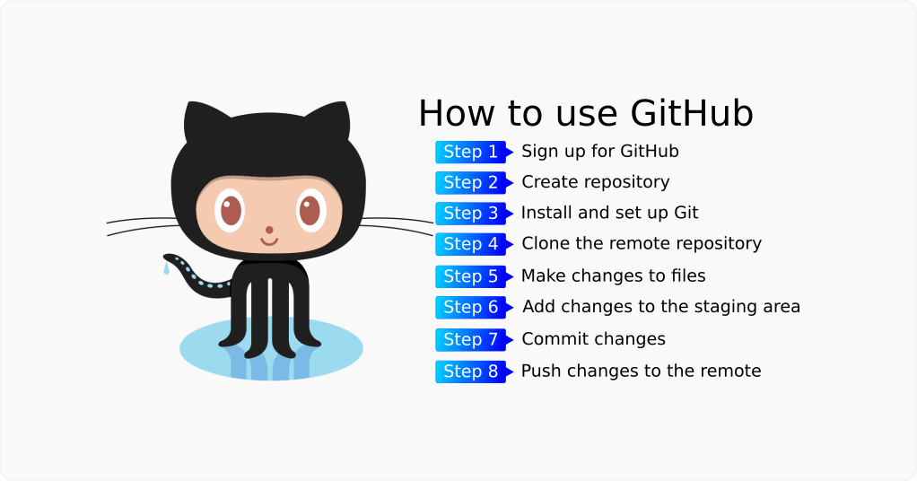
GitHub
GitHub – provides Git repository hosting services
While Git is a command line tool, GitHub provides a Web-based graphical interface
It allows us to share and publish code
GitHub allows for “forking” – copying a repository from one user’s account to another. This enables you to take a project that you don’t have write access to and modify it under your own account.
It also allows for collaboration – where multiple people can make changes to code and keep the versions synched.

Slide 4
Installing git
On a mac, it’s probably already installed. You can check by:
1. cmd-spacebar gets you to Spotlight
2. Type: Terminal
3. Once the terminal opens up, type: git - -version (no space between dashes)
4. If you get a version number back, it’s already installed. Otherwise, it’ll ask you if you want to install it.

Slide 5
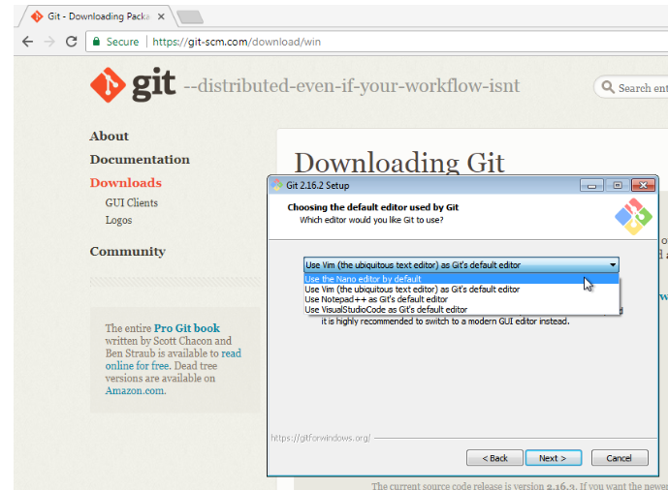
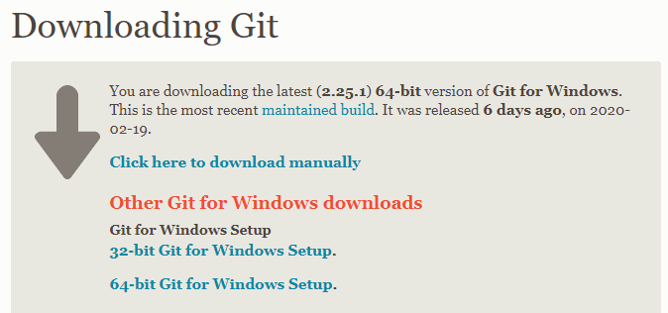
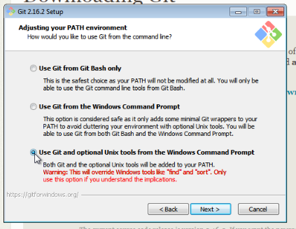
Installing git
On windows, it’s likely not installed. We will install git and Git Bash, which is automatically installed when we install Git for Windows, and allows us to interface with Rstudio
Search for: git for windows or go to: https://git-scm.com/download/win
Download the most recent maintained build (at the top)
Accept to run the installer and agree to license
Your text suggests using the Nano editor by default
Although this is not a universal recommendation
Under “How would you like to use Git from the command line?” select “Use Git and optional Unix tools from the Windows Command Prompt” unless you use your Windows command line frequently and don’t want its functionality to be altered.
Now continue with the default options.

Slide 6
Getting a GitHub account
Basic GitHub accounts are free.
Go to GitHub: https://github.com/ where you will see a box where you can sign up
Pick a name carefully. It should be short, easy to remember and to spell, something related to your name, and professional.
Once you have a GitHub account, you are ready to connect Git and RStudio to this account.

Slide 7
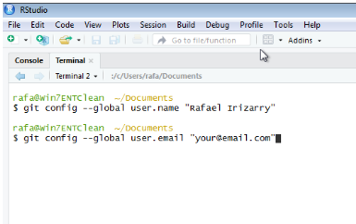
RStudio
In RStudio, go to Tools -> Terminal -> New Terminal
Then you type in the git config commands to tell Git who you are (should match GITHUB credentials):
In the terminal window, you should type:
git config --global user.name “Your Name”
git config --global user.email “your@email.com”

Slide 8
RStudio
Go to Tools -> Global Options and select Git/SVN
Then enter a path for the Git executable that we just installed
it likely is: C:/Program Files/Git/bin/git.exe
On my mac, I just kept the default path and it worked
We can create a SSH RSA Key which will reduce the frequency with which we need to enter our GitHub password. Select “Create RSA key”
Type in your password and confirm
Now GitHub can communicate with

Slide 9
GitHub Repositories
You can now create a GitHub Repository (repo).
This allows you to have 2 copies: 1 on GitHub and 1 on your computer
If you add collaborators then you’ll each have a copy on your computers.
Go to your github account: http://github.com/username
Sign in (if you need to)
Click on Repositories and then click New

Slide 10
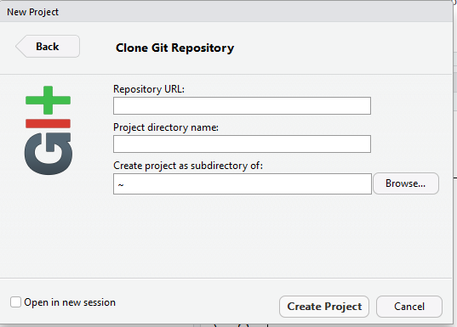
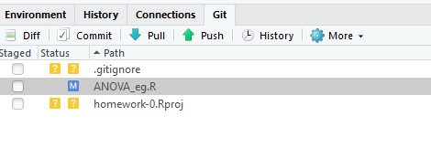
Clone to your computer
In GitHub, copy the link under “Clone or Download”
Then in Rstudio, go to New Project
Select “Version Control”
Select “Git”
Copy and paste the Repository URL
In the “Project Directory Name” put the name of the repo (e.g., homework-0)
This will create a folder called homework-0 on your local system
If you select the “Git” tab, it will show you the files on your project with some icons that give you information about these files.

Slide 11
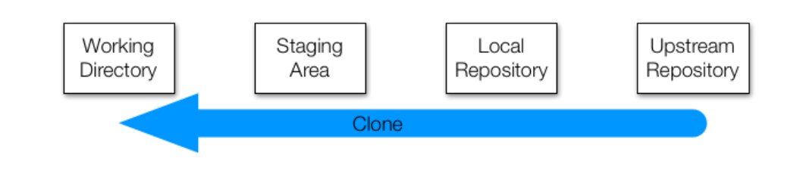
Working with GitHub
If we clone a project, we put it in our working directory
Once we make changes to our working directory, we need to put it back into our GitHub. How does this work?

Slide 12
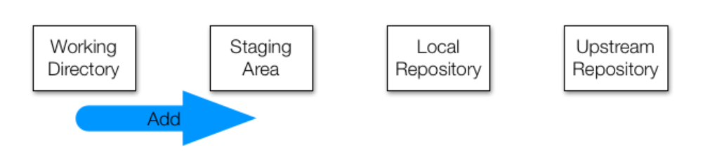
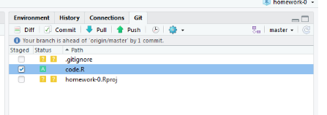
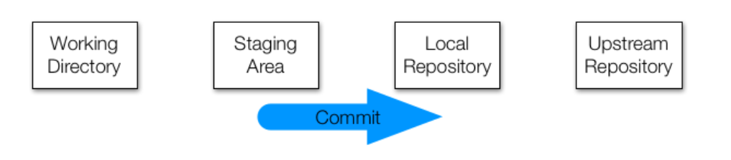
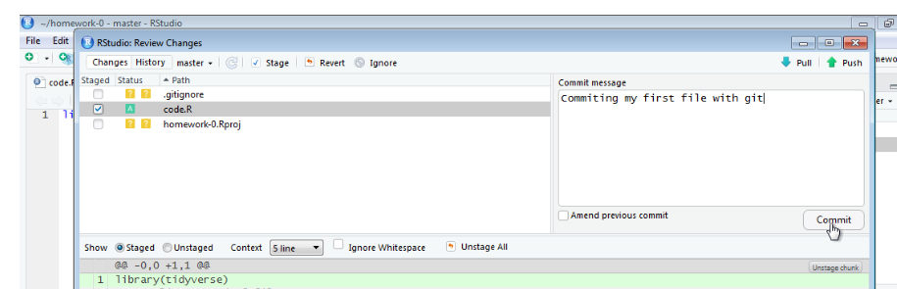
Staging Area -> Commit -> Local Repository -> Push -> GitHub Repository

Slide 13
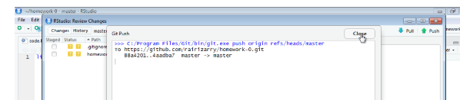
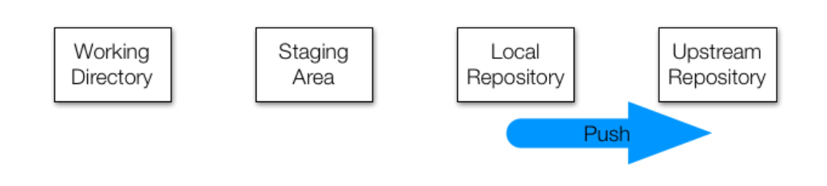
But…before you update the master branch
Be sure to “Pull” an updated version of the file before you push in case the file has changed (particularly if you are working with collaborators).

Slide 14
What do you do if your project has been edited?
When you pull it will give you an updated file.
Then you can select “Diff” to examine the changes and commit your additions.

Slide 15
Save it
Save the file
Stage it
Commit it (add in some description)
Pull
Push

